Slide 1
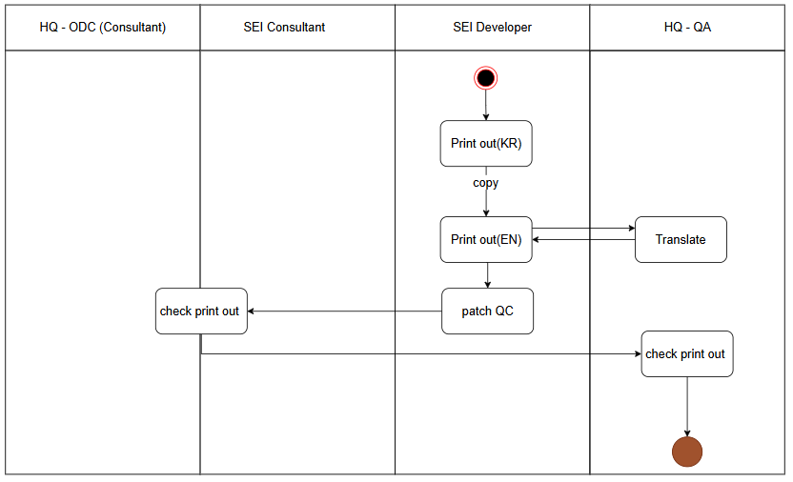
Spec Reg
Delivery
Dev
QA Request
QA Team Test

